Slide 1
DOCUMENT OBJECT MODEL

Slide 2
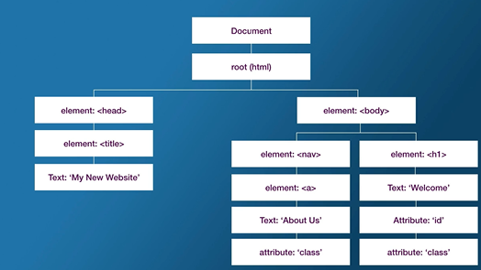

Slide 3
Document
This keyword is used to refer to the html document.
Through this keyword we can access:
All elements
The head
The body
The domain
The URL
The content type …. Etc.

Slide 4
GetElementByID
This will select element based on their ids.
You can change the style of an element.
Changing text Content

Slide 5
Query Selector
Syntax is similar to CSS;
You can select by a className ,id and by tags.
If multiple element share a className query selector will select the first only.
You can also nest just like css.
With Query selector you can get the first-child-last-child and n-th child.

Slide 6
SELECT MULTIPLE ELEMENT
getElementsByClassName
You can also nest like this:
document.querySelector('#secondary').getElementsByClassName('link');

Slide 7
getElementsByTagname
This is used to get one or more elements using the tag anme;

Slide 8
QuerySelectorAll
Used to Select Multiple Elements

